Slide 1


Employer Expectations
Quang Huynh

Slide 2

Dress Code
As an employer, I will set a casual attire as a dress code. An example would be a t-shirt and jeans. Suits and button-ups are optional. Be neat and avoid body odor.

Slide 3
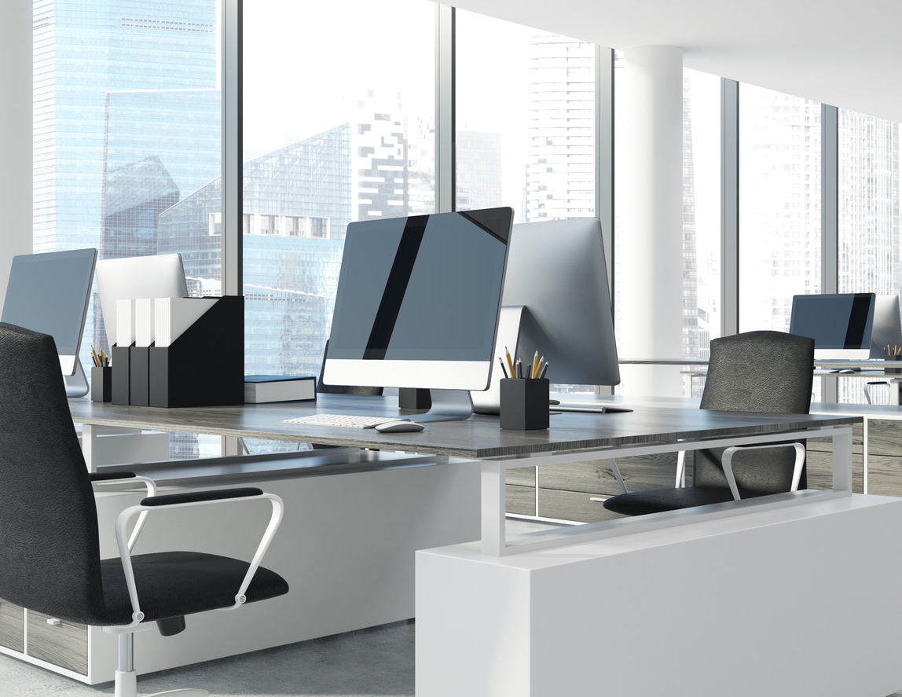
Proper use of the internet
Computer is intended for professional purposes only.
No personal use
The computers belong to the company and will be used for work.

Slide 4

Lunch times
Everyone has a break per day that is an hour long. Use this time to get lunch and do personal things.

Slide 5

No smoking
During work hours, you have to be sober, and smoking is not allowed.

Slide 6

Honesty
Don’t excessively call in sick when you don’t feel like going to work. Be on time and prepared for work.

Slide 7

Hours of work
Make sure to show up at 9:30 A.M. Work officially begins at that time and you are late if you aren’t there on time. Work ends at 6:00 P.M.

Slide 8

Be respectful to others
Do not create a hostile environment amongst the workplace.
Maintain a polite and kind attitude and be patient with your employees.
Do not discriminate others.

Slide 9

Safety
Learn and follow the safety procedures necessary.
Failure to do so will result in the loss of a job or injury.

Slide 10
Attitude
Be willing to cooperate with others
Be friendly and ready with a smile.
Use eye contact when talking to others.

Slide 11
Phone access
Only use your personal phone during break.
Any use of your phone while not on break will result in the confiscation of your phone.

